Slide 1
Dynamic Online Marketplace
Group No. 7
Anawat Pradabsuk 124039
Ritik Sareen 123844
Tanzil Al Sabah 123845
Munthitra Thadthapong 124022
Course: AT82.02 Data Modeling and Management
Course Instructor: Dr. Chutiporn Anutariya

Slide 2
Index
1
2
What is it?
Need of the Project
Page: 4
Page: 5
3
4
Business Rule and Constraints
Operations
Page: 6-7
Page: 8

Slide 3
Index
5
6
Queries & Report
Conceptual Diagram
Page: 9-10
Page: 11
7
8
Logical Diagram
EER Diagram
Page: 12-13
Page: 14
9
10
Data Dictionaries
Operations & Transactions
Page: 15-24
Page: 25-57

Slide 4



What is Dynamic Online Marketplace ?
Under "Selling," products are categorized as "First-hand," "Second-hand," or "Antique," each with its own marketplace. Our "Auctioning" feature provides a full auction service for users
Dynamic Online Marketplace is an online shopping app. It offers two selling options: "Selling" and "Auctioning," distinguishing it from other Thai apps.
Which only have one option.

Slide 5
Need of the Project
Giving sellers more options, offer two ways to sell products: "Selling" and "Auctioning”
Seller's Playground
Each category gets its own special marketplace. Ensuring everyone finds what they love.
Marketplace Magic
Let customers choose what they want by they can both sell and shop in “Secondhand” Categories.
Your Way, Your Choice
Customers can read reviews and see ratings to make informed decisions about the purchases.
Seller Ratings and Reviews

Slide 6
Business Rule and Constraints
User Registration
Product Listings
Bidding
User Reviews
Users must create an account with valid email addresses and secure passwords.
Sellers can list products for sale, specifying category (First-hand, Second-hand, Antique), product details, and price.
Auction listings should include starting bid, bid increment, and auction duration.
The platform may take action against sellers with consistently poor ratings.

Slide 7
Business Rule and Constraints
Compliance
Shipping and Delivery
The platform must comply with all relevant laws and regulations related to online marketplaces, e-commerce, and consumer protection.
Sellers are responsible for shipping the purchased items to buyers.
Shipping fees, delivery times, and tracking information should be provided to buyers.
Product Update
Order Cancellation
Product updates should include changes in price, quantity, product description.
Deleting items should be allowed to remove products that are no longer available.
Customers are unable to request order cancellation once it has been initiated

Slide 8
Operations
DELETE
● Customer ● Seller ● Product ● Order ● Address ● Review
INSERT
● New Customer ● New Seller ● New Product ● New Auction ● New Order ● New Secondhand Product ● New Review
UPDATE
● Customer Information ● Seller Information ● Product Description ● Product Review ● Sales Total ● Delivery Status

Slide 9
Queries and Report
Customer
Product Review
● Identify High-Value Customers ● Calculate Customer Ratings
● Average Review Ratings by Product
● Most Helpful Reviews
● Customers with the Most Reviews
Seller
Product
● Top-Rated Sellers ● Inventory Management
● Seller Performance Analysis
● Seller Location Insights
● Sellers with Multiple Store Locations
● List Top-Rated Products
● Products with High Discounts
● Available Stock Analysis
● Manufacturer Popularity
● Product Sales by Category
● High-Value Products
Address
Sells
● Popular Cities with High Delivery Demand
● Unique States with Seller Presence
● Pin Code-Based Delivery Tracking
● Top Sellers by Revenue
● Most Sold Products by Seller
● Sellers with Low Stock Products

Slide 10
Queries and Report
New
Second Hand
Auction
● List New Products with Discounts
● Find New Products with Warranty Information
● Total Revenue Generated by Each Seller for New Products
● List Secondhand Products with Warranty
● Find Recently Listed Secondhand Products
● Total Number of Secondhand Products per Seller
● Find the Most Expensive Auction
● List Auctions with No Bids
Auction Transaction
● List Products with No Bids
● Calculate Total Bid Amount by Customer
● Auction Transaction History

Slide 11
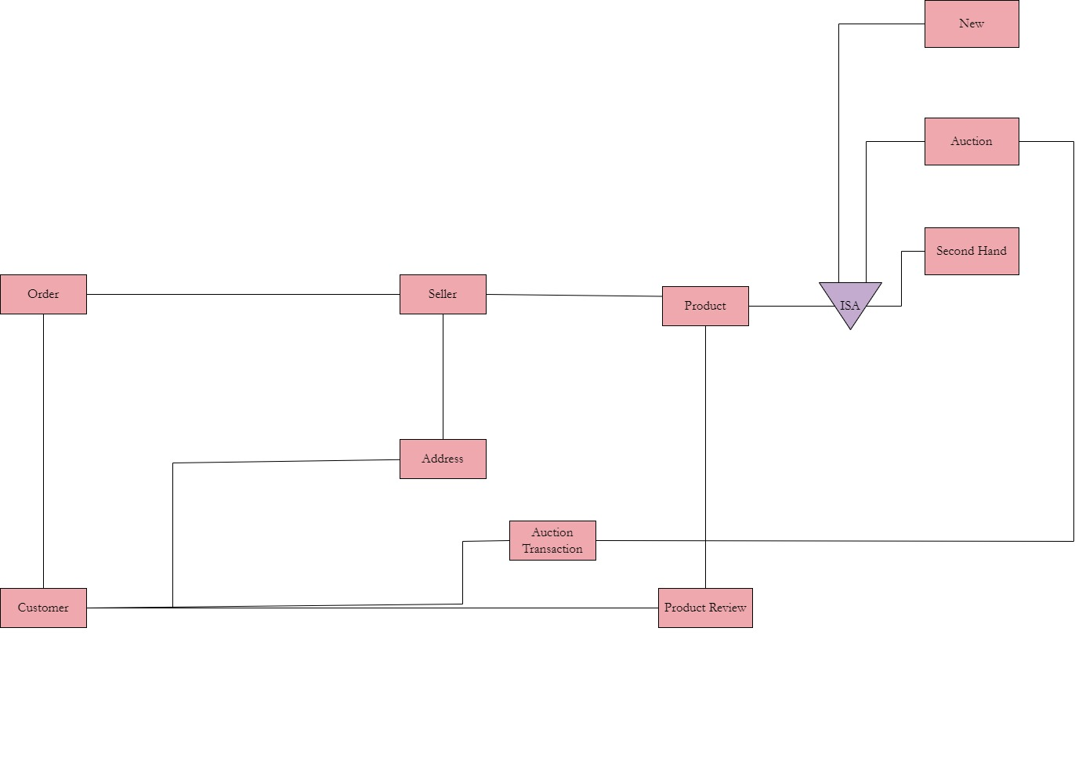
Conceptual Diagram

Slide 12
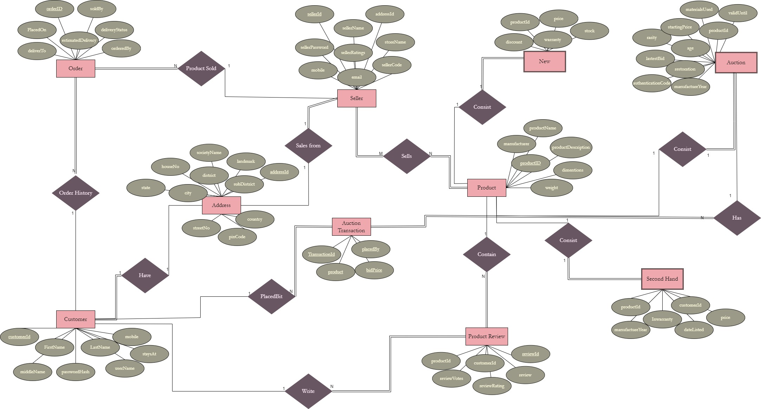
Logical Diagram

Slide 13
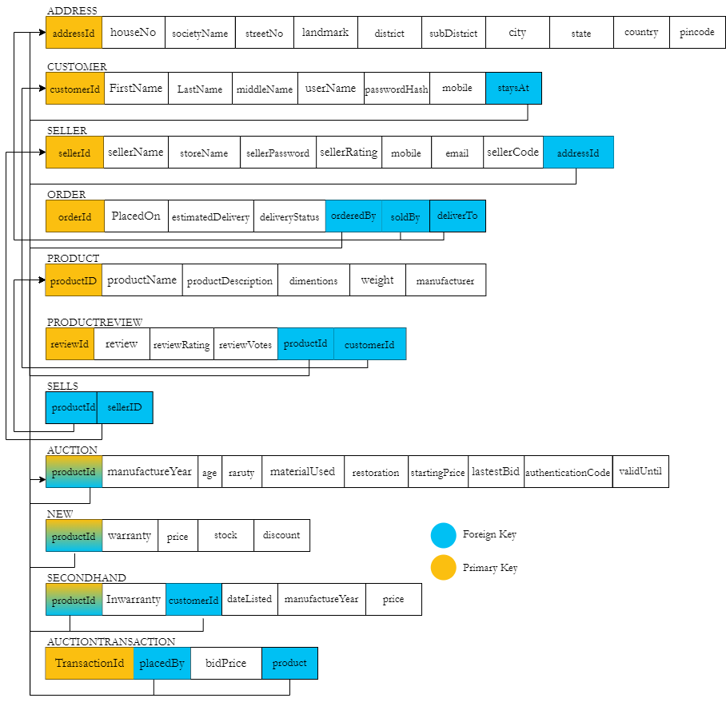

Logical Diagram

Slide 14
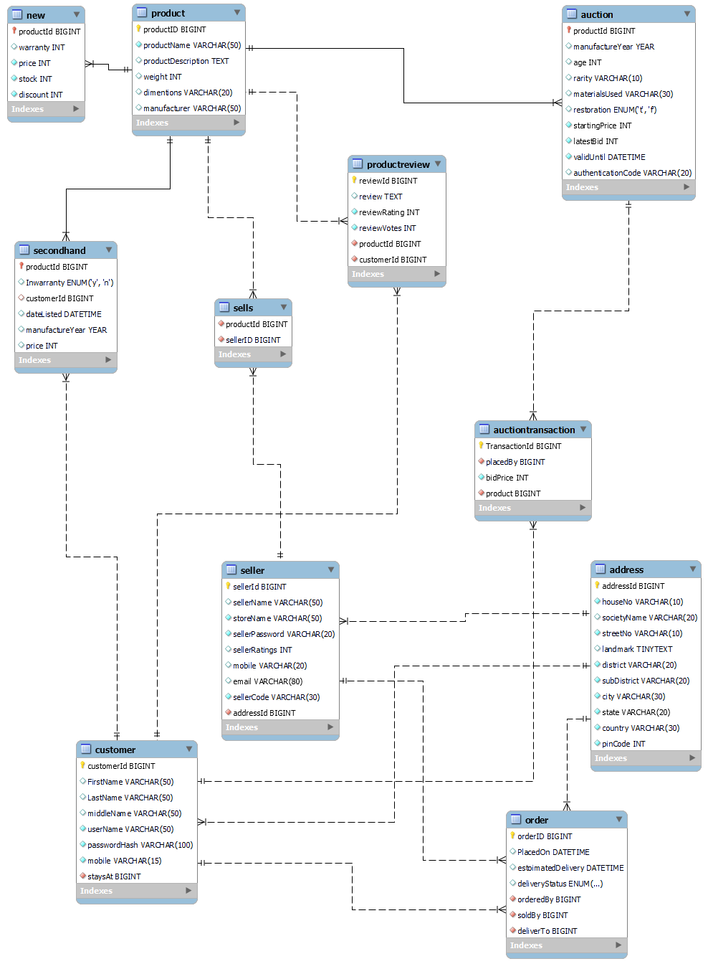
Extended
Entity
Relationship
Diagram

Slide 15
Data Dictionary - Customer

Slide 16
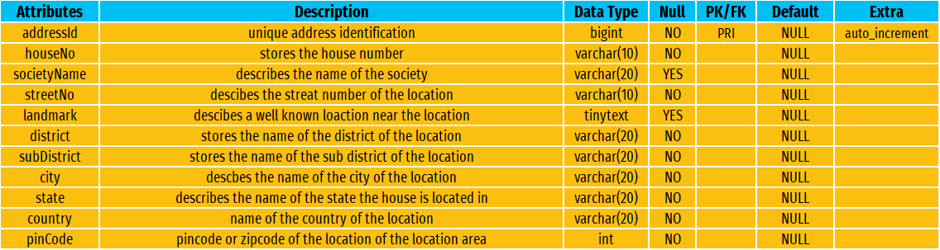
Data Dictionary - Address

Slide 17
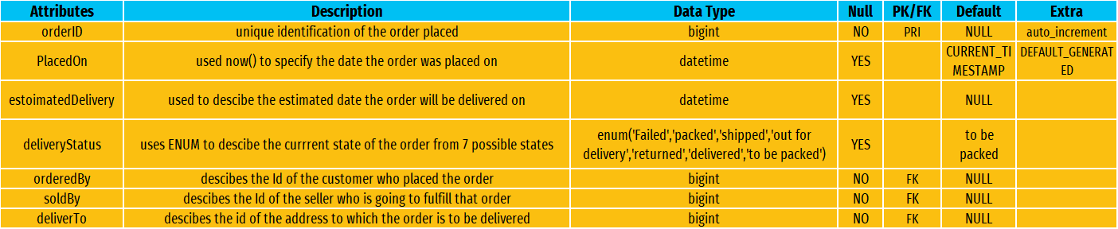
Data Dictionary - Order

Slide 18
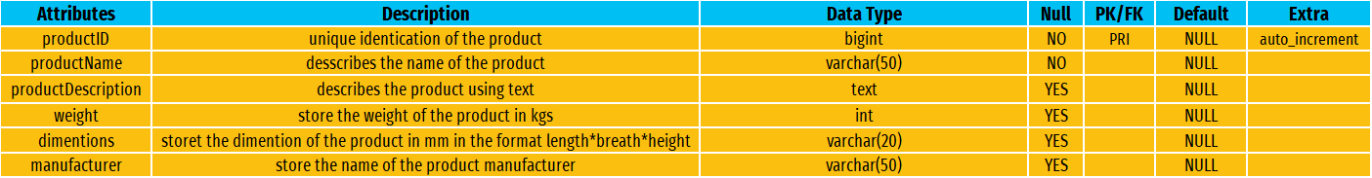
Data Dictionary - Product

Slide 19
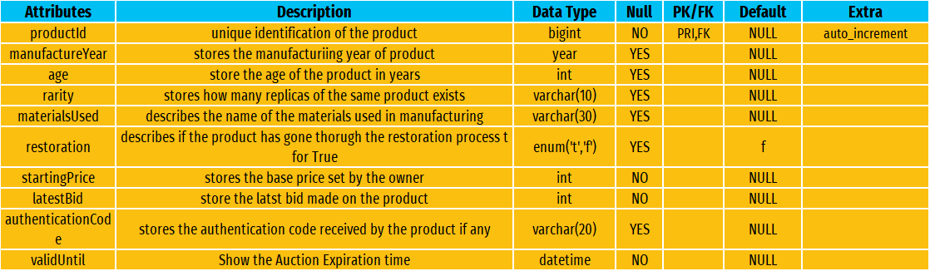
Data Dictionary - Auction

Slide 20
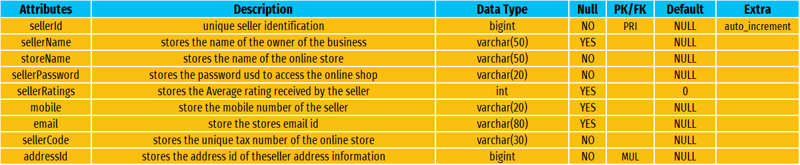
Data Dictionary - Seller

Slide 21
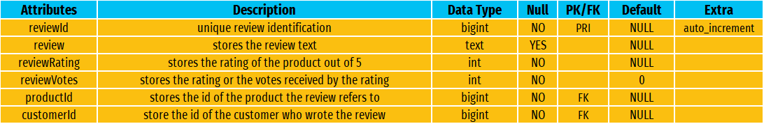
Data Dictionary - Review

Slide 22
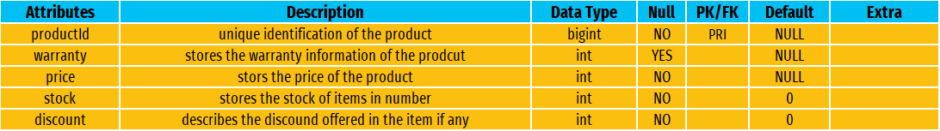
Data Dictionary - New

Slide 23
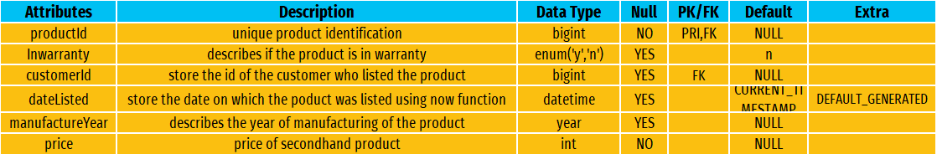
Data Dictionary - Second Hand

Slide 24
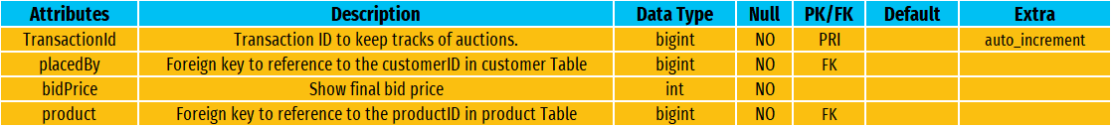
Data Dictionary - Auction Transaction

Slide 25
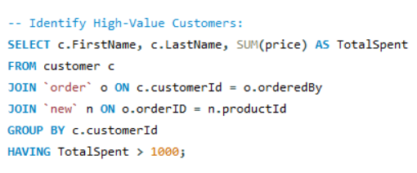
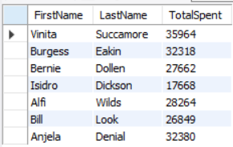
Operations & Transactions - Customer
Identify High-Value Customers
-----------------------------------------------------------------------
Query to identify customers who have spent more than a specified amount.

Slide 26
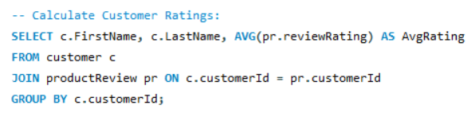
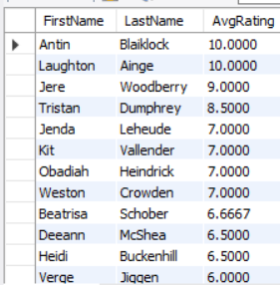
Operations & Transactions - Customer
Calculate Customer Ratings
----------------------------------------------------------------
Query to calculate the average ratings given by customers for products they've reviewed.

Slide 27
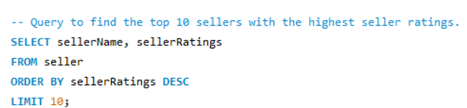
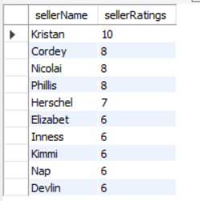
Operations & Transactions - Seller
Top-Rated Sellers
----------------------------------------------------------------
Query to find the top 10 sellers with the highest seller ratings.

Slide 28
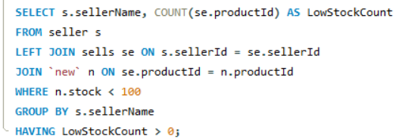
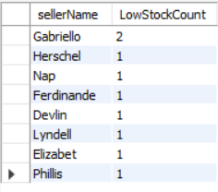
Operations & Transactions - Seller
Inventory Management
----------------------------------------------------------------
Query to identify sellers with low stock levels for restocking.

Slide 29
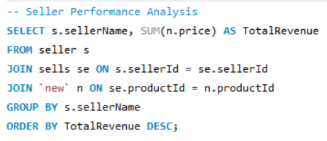
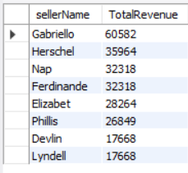
Operations & Transactions - Seller
Seller Performance Analysis
----------------------------------------------------------------
Query to analyze seller performance by calculating the total revenue generated.

Slide 30
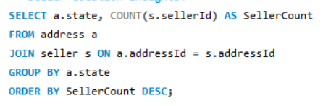
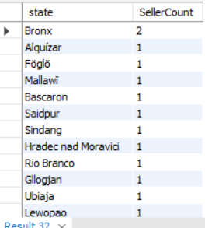
Operations & Transactions - Seller
Seller Location Insights
----------------------------------------------------------------
Query to analyze the distribution of sellers by state for targeted partnerships.

Slide 31
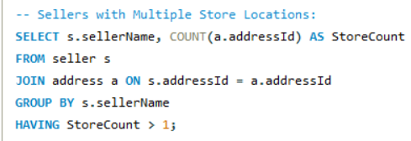
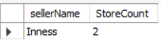
Operations & Transactions - Seller
Sellers with Multiple Store Locations
-------------------------------------------------------------------------------------
Query to find sellers with multiple store locations for potential collaborations.

Slide 32
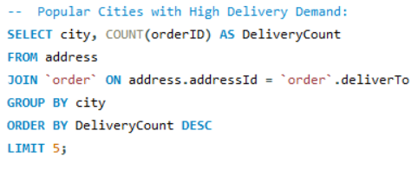
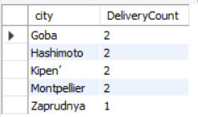
Operations & Transactions - Address
Popular Cities with High
Delivery Demand
---------------------------------------------------------------------------
Query to find the top 5 cities with the highest number of delivery orders.

Slide 33
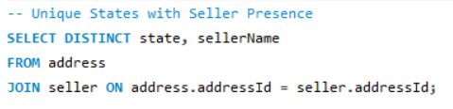
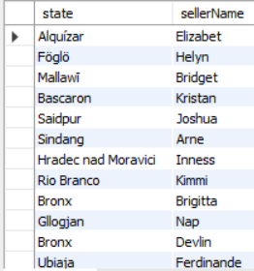
Operations & Transactions - Address
Unique States with Seller Presence
---------------------------------------------------------------------------------
Query to list the unique states where sellers are located.

Slide 34
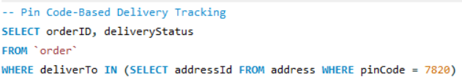
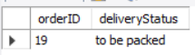
Operations & Transactions - Address
Pin Code-Based Delivery Tracking
-------------------------------------------------------------------------------
Query to track the status of orders delivered to a specific pin code.

Slide 35
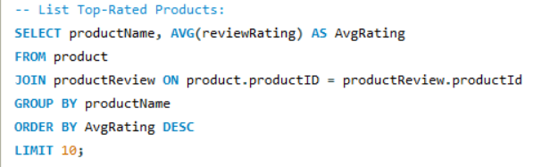
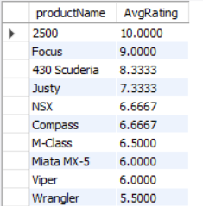
Operations & Transactions - Product
List Top-Rated Products
-------------------------------------------------------------------------------
Query to find the top-rated products based on average review ratings.

Slide 36
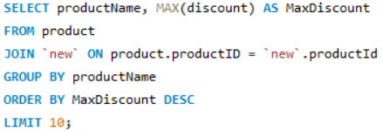
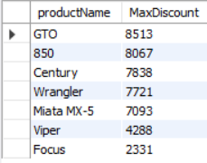
Operations & Transactions - Product
Products with High Discounts
---------------------------------------------------------------------------------
Query to list products with the highest discounts.

Slide 37
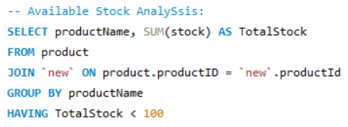
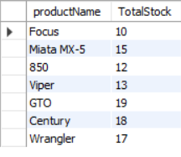
Operations & Transactions - Product
Available Stock Analysis
-------------------------------------------------------------------------------
Query to analyze products with low stock levels.

Slide 38
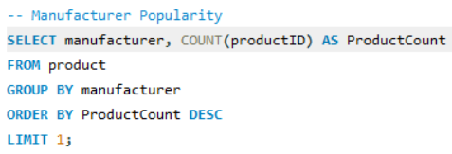
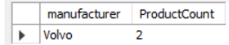
Operations & Transactions - Product
Manufacturer Popularity
---------------------------------------------------------------------------
Query to find the most popular manufacturer based on the number of products.

Slide 39
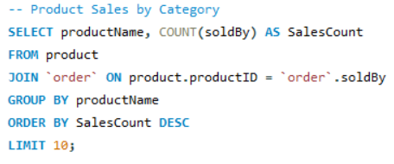
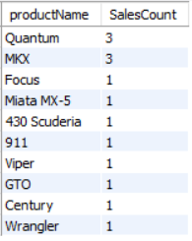
Operations & Transactions - Product
Product Sales by Category
------------------------------------------------------------------------
Query to analyze product sales by category (product name).

Slide 40
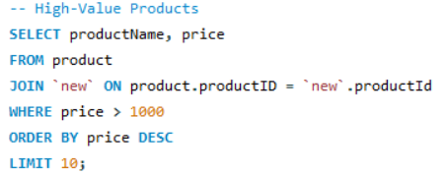
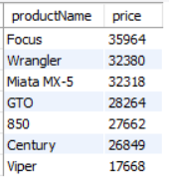
Operations & Transactions - Product
High-Value Products
-------------------------------------------------------------------------
Query to identify high-value products with a price above a certain threshold.

Slide 41
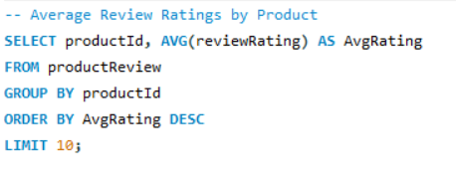
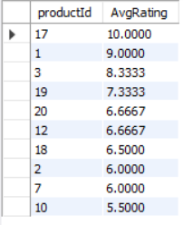
Operations & Transactions - Product Review
Average Review Ratings
by Product
---------------------------------------------------------------------------
Query to calculate the average review ratings for each product.

Slide 42
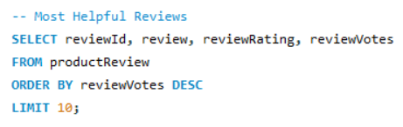
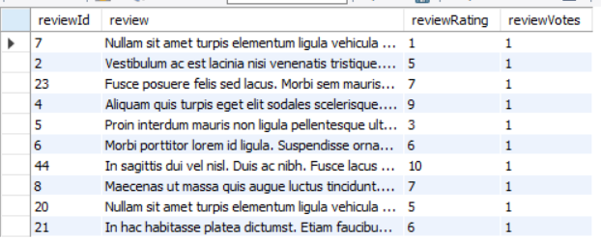
Operations & Transactions - Product Review
Most Helpful Reviews
-----------------------------------------------------------------------------
Query to find the most helpful product reviews based on review votes.

Slide 43
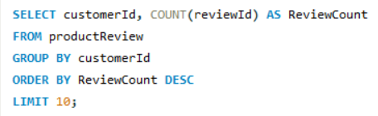

Operations & Transactions - Product Review
Customers with the Most Reviews
-----------------------------------------------------------------------------
Query to identify customers who have submitted the most product reviews.

Slide 44


Operations & Transactions - Sells
Top Sellers by Revenue
-----------------------------------------------------------------------------
Query to find the top-selling sellers based on the total revenue generated from their sales.

Slide 45


Operations & Transactions - Sells
Most Sold Products by Seller
-----------------------------------------------------------------------------
Query to identify the products that each seller has sold the most.

Slide 46
Operations & Transactions - Sells
Sellers with Low Stock Products
-----------------------------------------------------------------------------
Query to list sellers who have products in low stock (stock count less than a specified threshold).

Slide 47


Operations & Transactions - Second Hand
List Secondhand Products
with no Warranty
-----------------------------------------------------------------------------
Query to retrieve secondhand products that don’t have warranty coverage.

Slide 48


Operations & Transactions - Second Hand
Find Recently Listed Secondhand Products
-----------------------------------------------------------------------------
Query to list secondhand products that have been recently listed for sale.

Slide 49


Operations & Transactions - Second Hand
Total Number of Secondhand Products per Seller
-----------------------------------------------------------------------------
Query to calculate the total number of secondhand products listed by each seller.

Slide 50


Operations & Transactions - New
List New Products with Discounts
-----------------------------------------------------------------------------
Query to retrieve new products that have discounts applied.

Slide 51


Operations & Transactions - New
Find New Products with Warranty Information
-----------------------------------------------------------------------------
Query to list new products that come with warranty coverage.

Slide 52


Operations & Transactions - New
Total Revenue Generated by Each Seller for New Products
-----------------------------------------------------------------------------
Query to calculate the total revenue generated by each seller from selling new products.

Slide 53


Operations & Transactions - Auction
Find the Most Expensive Auction
-----------------------------------------------------------------------------
Query to find the auction with the highest current bid.

Slide 54


Operations & Transactions - Auction
List Auctions with No Bids
-----------------------------------------------------------------------------
Query to identify auctions that have received no bids.

Slide 55


Operations & Transactions - Auction Transaction
List Product with No Bids
-----------------------------------------------------------------------------

Slide 56


Operations & Transactions - Auction Transaction
Calculate Total Bid Amount by Customer
-----------------------------------------------------------------------------

Slide 57


Operations & Transactions - Auction Transaction
Auction Transaction History
-----------------------------------------------------------------------------

Slide 58
THANK YOU

